Slide 1
DPR
Iterator pattern

Slide 2

Introduction
Gives access to data structures without exposing internal structure
Notes:
As the name says, is provdes acces to elements, it iterates them

Slide 3
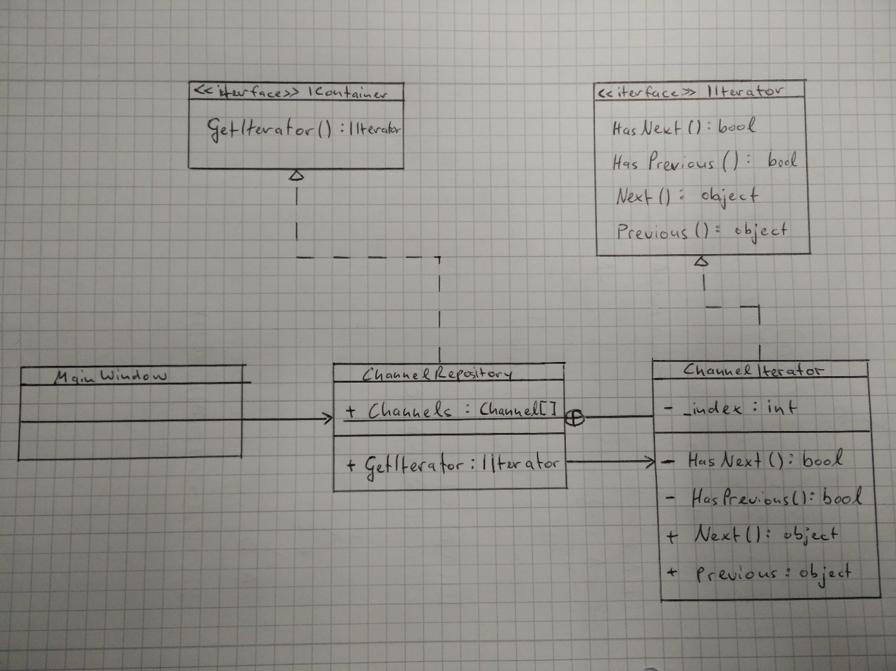

Slide 4
Reusability
ChannelIterator is independent of the type of the data structure given
IIterator

Slide 5
Maintainability
data structure inside ChannelRepository and the iterator protocol in ChannelIterator separated units which can be easily changed without affecting neither
Meaning that the data structure is independent of the iterator protocol or vice versa
Unit tests

Slide 6
Extensibility
IContainer can offer multiple methods which describe different iterator protocols

